Slide 1
Sect. 5.4 Graphing Exponential and Logarithmic Functions with Transformations
© Copyright all rights reserved to Homework depot: www.BCMath.ca

Slide 2
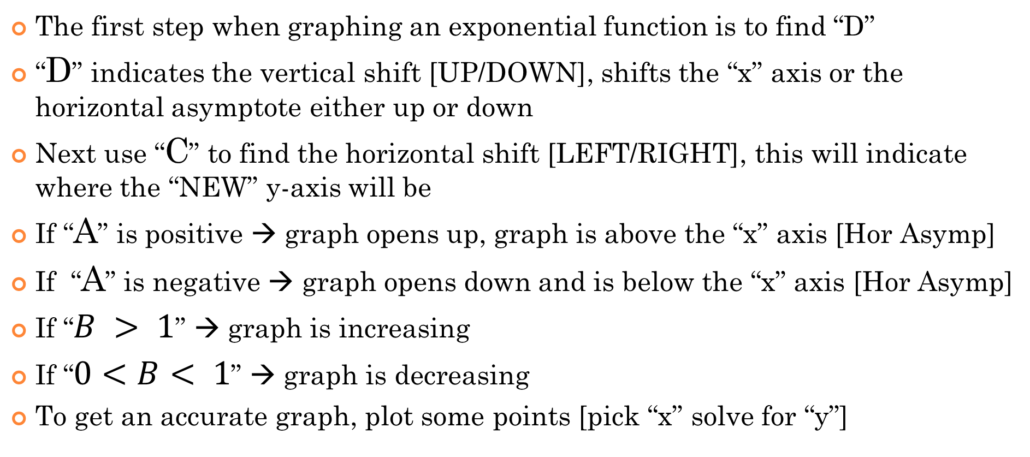
Exponential Functions with Transformations:
The first step when graphing an exponential function is to find “D”
“D” indicates the vertical shift [UP/DOWN], shifts the “x” axis or the horizontal asymptote either up or down
Next use “C” to find the horizontal shift [LEFT/RIGHT], this will indicate where the “NEW” y-axis will be
If “A” is positive → graph opens up, graph is above the “x” axis [Hor Asymp]
If “A” is negative → graph opens down and is below the “x” axis [Hor Asymp]
If “$B > 1$” → graph is increasing
If “$0<B< 1$” → graph is decreasing
To get an accurate graph, plot some points [pick “x” solve for “y”]

Slide 3
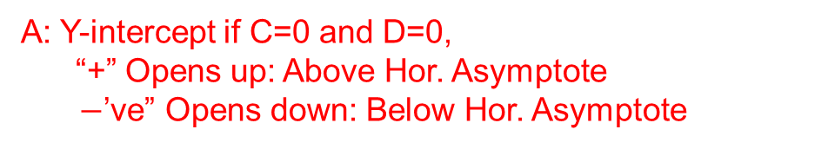
Graphing Exponential Functions with Transformations:
The general formula for an exponential function is in the form:
y
y
A: Y-intercept if C=0 and D=0, “+” Opens up: Above Hor. Asymptote
$−$’ve” Opens down: Below Hor. Asymptote
4
4
3
3
2
B: “Base” of the exponential function, B > 1 – Graph increases AWAY from the horizontal asymptote 0 < B < 1 – Graph decreases CLOSER to the horizontal asymptote
B < 0 – Not an exponential function
2
1
1
x
x
-4
-4
-3
-3
-2
-2
-1
-1
0
0
1
1
2
2
3
3
4
4
-1
-1
-2
-2
-3
-3
C: Horizontal shift: Indicates where the “new” y-axis will be
-4
-4
D: Vertical shift: Indicates the new Horizontal asymptote

Slide 4
Graphing Exponential Functions
When graphing an exponential function, start with “D” and “C”. Then map a few points afterwards
Ex: Find the values of “A”, “B”, “C”, & “D, then graph the function:
y
D = 2, Horizontal Asymptote at y=2
12
C = 3, The y-axis is shifted 3 units Right
A = 0.5, the y-int was supposed to be 0.5 units above the Horizontal asymptote
10
8
B = 2, The graph is increasing, plot a few points needed to complete the graph
6
4
2
x
-3
-2
-1
0
1
2
3
4
5
6
7
8
9

Slide 5
Graph the following exp. Functions, indicate the values “a, b, c, and d”, state the domain and range
D = 10, Horizontal Asymptote at y=10
C = -1, The y-axis is shifted 1 units Left
y
A = -1.5, Graph opens down and the y-int was supposed to be -1.5 under the H.A.
12
B = 0.8, The graph is decreasing, plot a few points needed to complete the graph
10
8
6
4
Range is incorrect….. What should it be??
2
x
-3
-2
-1
0
1
2
3
4
5
6
7
8
9

Slide 6
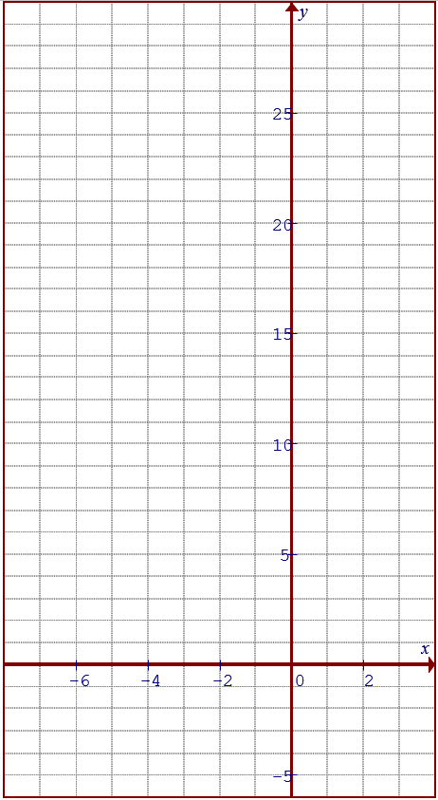
D = -5, Horizontal Asymptote at y= -5
Factor the “3” in the exponent
C = -2, The y-axis is shifted 2 units Left
A = 2.5, the y-int was supposed to be 2.5 units above the Horizontal asymptote
B = 8, The graph is increasing, plot a few points needed to complete the graph
Range is incorrect….. What should it be??

Slide 7
Changing the Base to remove coefficient of “x”
If there are negative exponents, turn it into the reciprocal of the base:
A horizontal reflection will turn an increasing graph to a decreasing graph
If the exponent has a coefficient, factor it out and then use it to change the base
The base is changed from “2” to 8

Slide 8





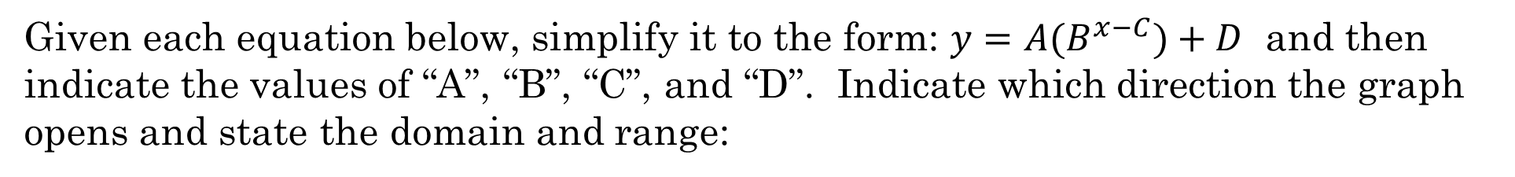

Given each equation below, simplify it to the form: $y=A(B^{x−C})+D$ and then indicate the values of “A”, “B”, “C”, and “D”. Indicate which direction the graph opens and state the domain and range:
The exponent “x” has a coefficient of “3”. Factor this out.
Change the base from “2” to 8, since 2³=8
A=3/2
Opens UP
C=$−2$(left 2)
B=8
Increasing Function
D=$−5$(down 5)
$$A=−1.25$$
Opens Down
The exponent “x” has a coefficient of “0.5”. Factor this out.
$$B=\sqrt{3}$$
Increasing Function
C= $−12$(left 12)
D=$11 (Up 11 )$

Slide 9
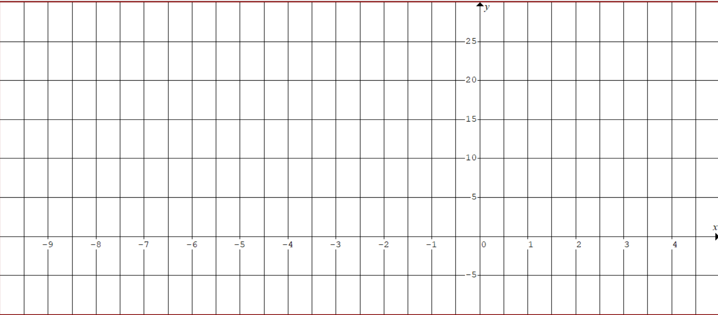
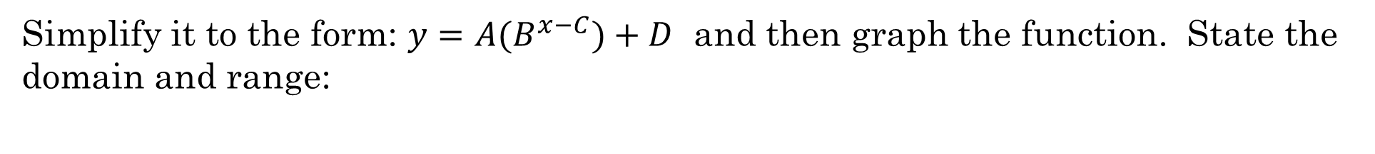
Simplify it to the form: $y=A(B^{x−C})+D$ and then graph the function. State the domain and range:
D = -5, Horizontal Asymptote at y= -5
Factor the “3” in the exponent
C = -2, The y-axis is shifted 2 units Left
A = 2.5, the y-int was supposed to be 2.5 units above the Horizontal asymptote
B = 8, The graph is increasing, plot a few points needed to complete the graph
Range is incorrect….. What should it be??

Slide 10
Graphs of Logarithmic Functions:
The graph of a logarithmic function is the “INVERSE” of an exponential function
The graph of $y={10}^{x} and y=logx$ are reflections of each other over the line $y=x$
Exponential Function:
Inverse Reflection:
Logarithmic Equation:
y
4
3
2
1
x
-4
-3
-2
-1
0
1
2
3
4
-1
-2
-3
-4

Slide 11
Logarithmic Functions are Inverses of Exponential Functions
The graph of a logarithmic function is an inverse function of an exponential function with the same base
Exponential Function:
Inverse Reflection:
Logarithmic Equation:
y
4
3
2
1
x
-4
-3
-2
-1
0
1
2
3
4
Since we have a restriction at x > 0, we have a vertical asymptote at x=0
-1
-2
-3
-4

Slide 12
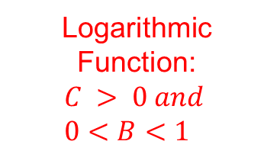
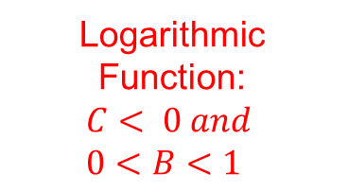
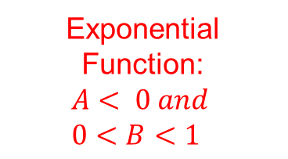
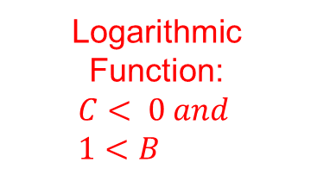
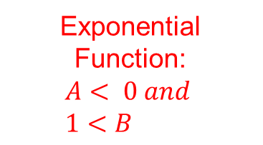
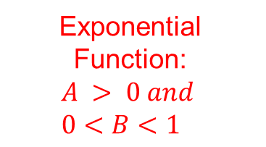
Inverse of Different Exponential Functions:
Exponential Function: $$A > 0 and \\ 0<B<1$$
Logarithmic Function: $$C > 0 and \\ 0<B<1$$
Exponential Function: $$A< 0 and \\ 1<B$$
Logarithmic Function: $$C< 0 and \\ 1<B$$
Exponential Function: $$A< 0 and \\ 0<B<1$$
Logarithmic Function: $$C< 0 and \\ 0<B<1$$
Decreasing Function
Vertical Reflection
y
y
y
4
4
4
3
3
3
2
2
2
1
1
1
x
x
x
-4
-3
-2
-1
0
1
2
3
4
-4
-3
-2
-1
0
1
2
3
4
-4
-3
-2
-1
0
1
2
3
4
-1
-1
-1
-2
-2
-2
-3
-3
-3
-4
-4
-4

Slide 13




How to Read a Logarithmic Function:
When reading or graphing a logarithmic function, start by looking at the value of the base “B”
If the “base” is bigger than 1, then it will open from bottom and go up!
If the “base” is between 0 and 1, then it will open from the top and go down
$$C< 0$$
y
y
4
$$C > 0$$
4
3
3
2
2
1
1
x
x
-4
-3
-2
-1
0
1
2
3
4
-4
-3
-2
-1
0
1
2
3
4
-1
-1
-2
-2
-3
-3
-4
-4
$$C< 0$$
$$C > 0$$

Slide 14
Make it Simple: Keep “A” positive
If the leading coefficient “A” is negative, remove the negative sign by “flipping” the base!
One log property is that you can move the exponent of the base to the front as a coefficient
In contrast, if the leading coefficient is negative, move that negative sign to become an exponent for the base
A value to the power of -1 is equal it’s reciprocal
By flipping the base, we removed the negative sign in the coefficient and wont need to perform a vertical reflection

Slide 15











Ex: Given each function, state the values of “A”, “B”, “C”, “D” and “E”.
ii) Indicate which way the graph opens, UP, DOWN, LEFT, or RIGHT. |
iii) Find the equation of the Vertical Asymptote, “X” intercept, and “Y” intercept.
$$Y−int: (x=0)$$
A:
B:
C: D: E:
$$=2$$
$With 0<B<1$ the graph opens down
$$=0.8$$
$With 0<C$ the graph opens to the right
$$=5$$
$$=3$$
$$Vertical Asymptote$$
$$No Y−intercept$$
$$=1$$
$$X−int: (y=0)$$

Slide 16











First get rid of the negative sign in the coefficient by flipping the base!
$$Y−int: (x=0)$$
$$Y−intercept(0,19.913)$$
A:
B:
C: D: E:
$$=3$$
$With 1<B$ the graph opens up
$$=4/3$$
$$X−int: (y=0)$$
$With C<0$ the graph opens to the left
$$=−7$$
$$=12$$
$$Vertical Asymptote$$
$$=−6$$

Slide 17
Ex: Graph the following function:
i) Find the eqn of the VA
ii) Indicate the domain and range
V.A.:
y
2
X-int:
x
-4
-2
0
2
4
6
8
-2
-4
-6
Base is 10, so graph
will open UP!
-8
© Copyright all rights reserved to Homework depot: www.BCMath.ca

Slide 18
Graph the following functions:
i) State the equations of the Vertical asymptotes
ii) Find the coordinates of the “x” intercept
iii) Find the domain and Range:

Slide 19
Ex: Graph
V.A.:
X-int:
y
10
8
6
4
2
Now pick a nice number for “x” s.t. (3-2x) is a power of 2
x
-4
-3
-2
-1
0
1
2
3
4
-2
-4
-6
DOMAIN:
-8
-10
Range:

Slide 20
Graph the following function
V.A.:
X-int:
y
6
4
2
x
-2
0
2
4
6
8
Now pick a nice number for “x” s.t. (6-2x) is a power of 3
-2
-4
-6
-8
-10
DOMAIN:
-12
-14
Range:

Slide 21
Ex: Indicate the transformations, vertical asymptote, domain, and X-intercept with each of the following equations
V.C. by a factor of 2/3
H.S. of 4 units right
X-intercept
V.A.:
Domain:
V.R. and V.E. by a factor of 4
H.C. by a factor of ½
H.S. 1.5 units right
V.S. 3 units up
V.A.:
X-intercept
Domain:
© Copyright all rights reserved to Homework depot: www.BCMath.ca

Slide 22
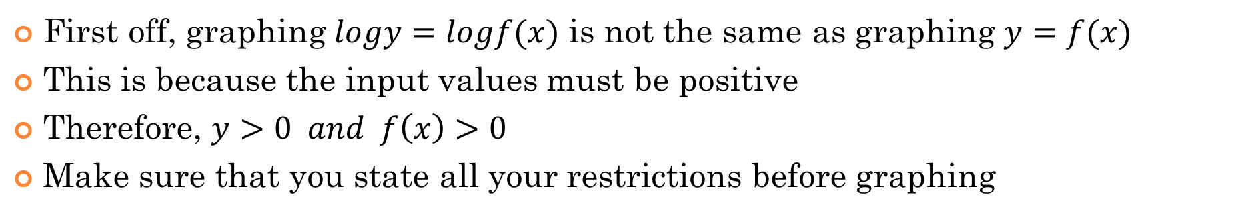
Graphing Logarithmic functions:
First off, graphing $logy=logf(x)$ is not the same as graphing $y=f(x)$
This is because the input values must be positive
Therefore, $y>0 and f\left(x\right)>0$
Make sure that you state all your restrictions before graphing
Note: The graphs of
and
are not the same!!
“x” can not be negative!!
“x” can be all real values…
“x” can not be negative!!
Q: Graph the function and indicate the domain and range?

Slide 23
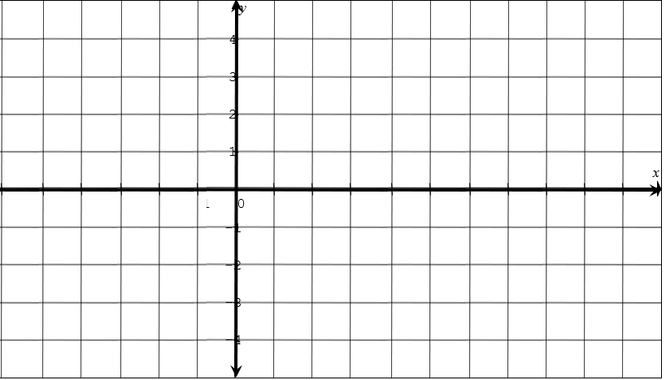
Q: Graph the function and indicate the domain and range?
y
10
8
6
4
2
x
-8
-6
-4
-2
0
2
4
6
8
-2
-4
-6
-8
-10

Slide 24
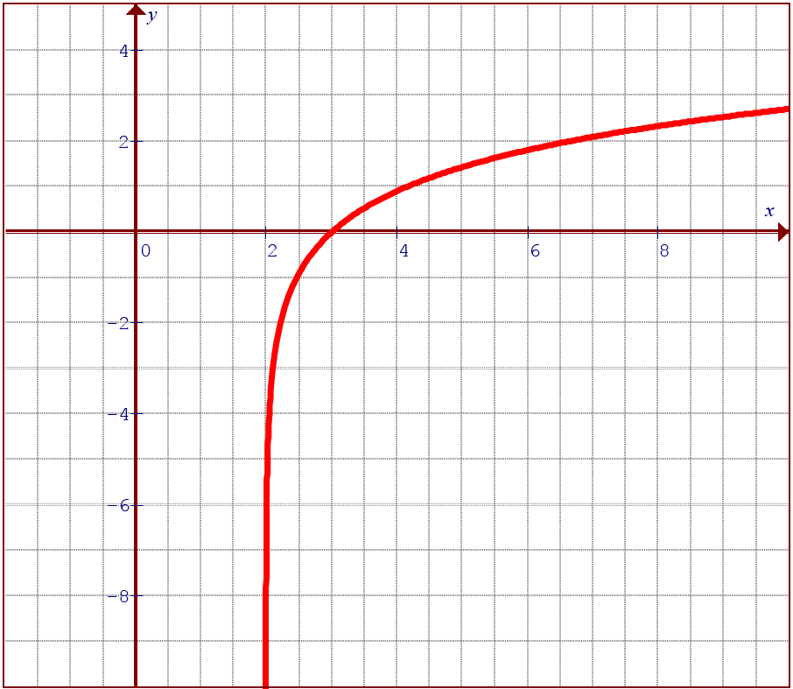
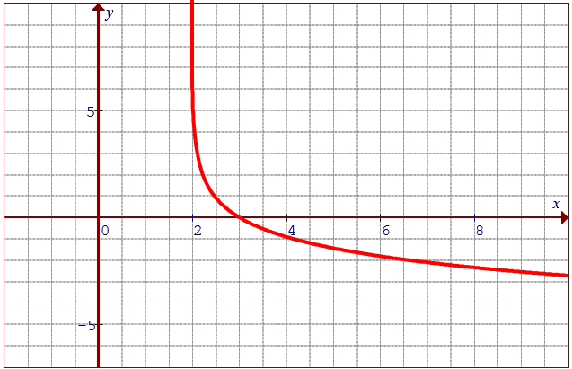
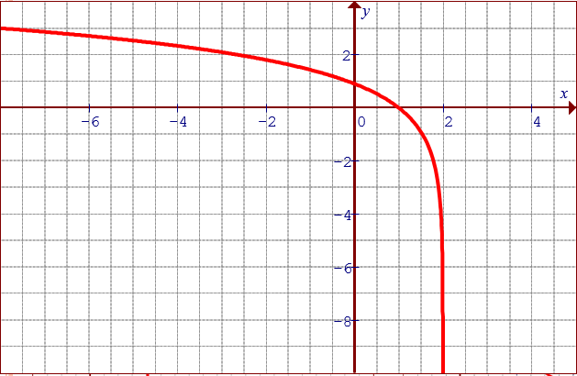
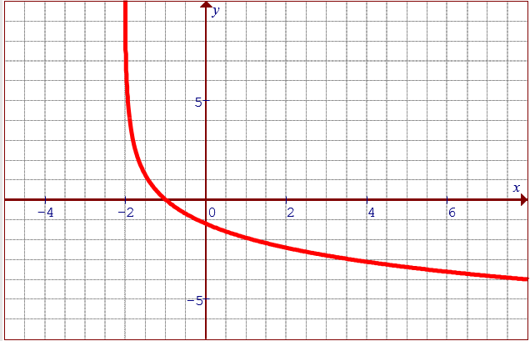
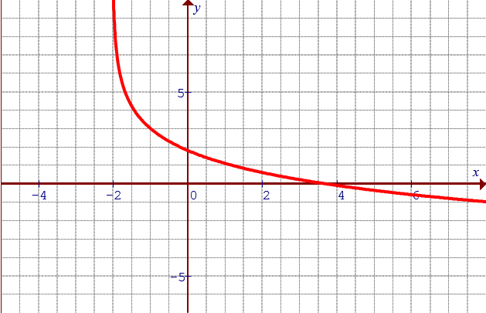
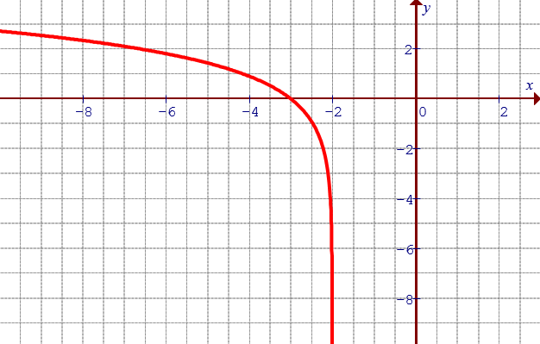
Match each Graph with the correct equation:

Slide 25
Ex: The following function is reflected over the y-axis. Which of the following will be the resulting equation?
A reflected over the y-axis is a H.R.
Note: A H.R. will occur when you take
the reciprocal of the base in an
exponential function
© Copyright all rights reserved to Homework depot: www.BCMath.ca

Slide 26
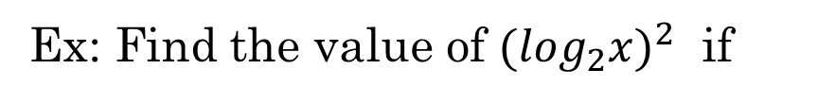
Challenge: Suppose
Find the value of:
(AoPS)
Suppose:
and
What is the value of “k”?
ARML
Ex: Find the value of ${(\log_{2}x)}^{2}$ if
AIME

Slide 27
Challenge: Suppose
Find the value of:
(AoPS)

Slide 28
Suppose:
and
What is the value of “k”?
ARML

Slide 29
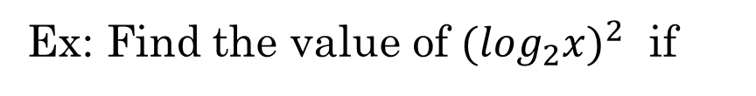
Ex: Find the value of ${(\log_{2}x)}^{2}$ if
AIME

